Slide 1
Project Presentation [DS8008 NLP (Text Mining)]
Bhupinder Singh
Richa Sharma

Slide 2
Topic Modelling and Search with Top2Vec
Topic Modeling is used for discovering latent semantic structure, usually referred to as topics, in a large collection of documents. Traditional topic modeling methods are Latent Dirichlet Allocation (LDA) and Probabilistic Latent Semantic Analysis (PLSA), which have several weaknesses despite their popularity. Top2Vec, the proposed model in the research paper that we studied, addresses these weaknesses and finds topics that are significantly more informative and representative of the corpus than the ones generated by traditional models.

Slide 3
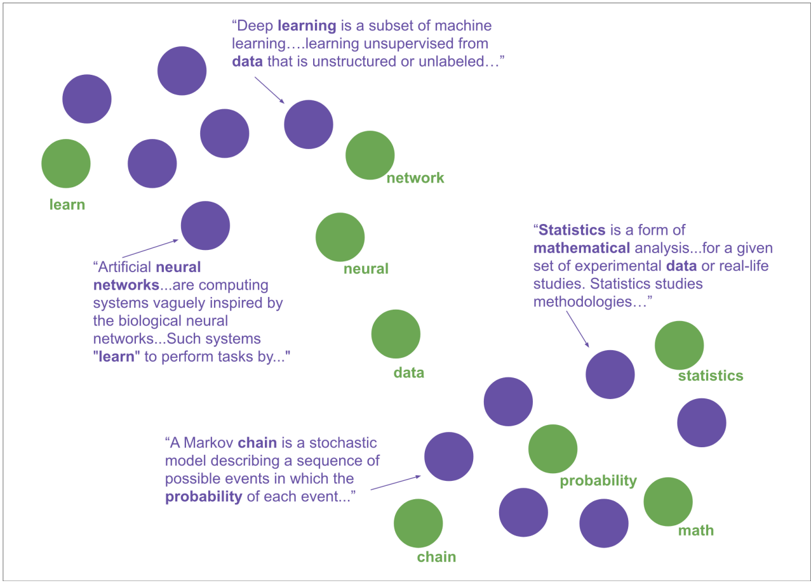
Jointly embedded document and word vectors
Uses the doc2vec model and its Distributed Bag of Words (DBOW) architecture, essentially converting each document and each unique word to a numeric representation, document vector and word vector respectively.

Slide 4
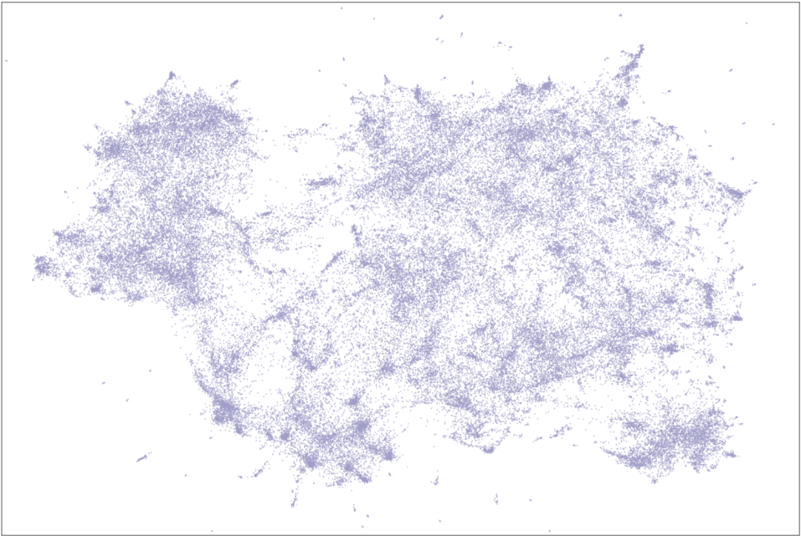
Dimensionality Reduction
In the high-dimensional semantic space, the document vectors are very sparse, which in turn makes it difficult to find dense clusters as it is computationally expensive. Thus, dimensionality reduction is performed on the document vectors with the UMAP algorithm (Uniform Manifold Approximation and Projection for Dimension Reduction).

Slide 5
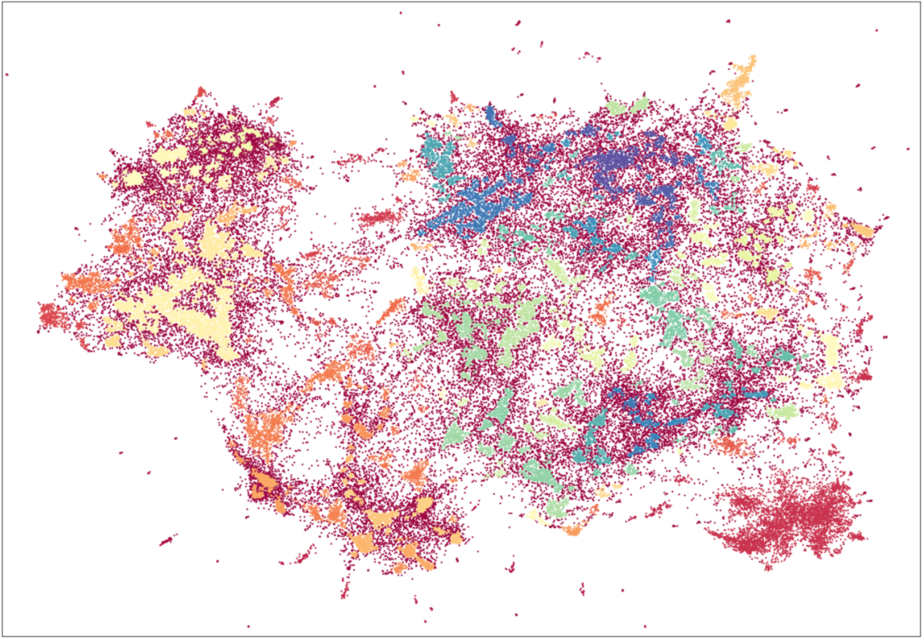
Clustering
The goal of density-based clustering is to find areas of highly similar documents in the semantic space, which indicate an underlying topic. This is performed on the UMAP reduced document vectors. HDBSCAN (Hierarchical Density-Based Spatial Clustering of Applications with Noise) is used to find the dense areas of document vectors. It assigns a label to each dense cluster of document vectors and assigns a noise label to all document vectors that are not in a dense cluster. The dense areas of identified document vectors will be used to calculate the topic vectors. Documents that are classified as noise can be seen as not being descriptive of a prominent topic.

Slide 6
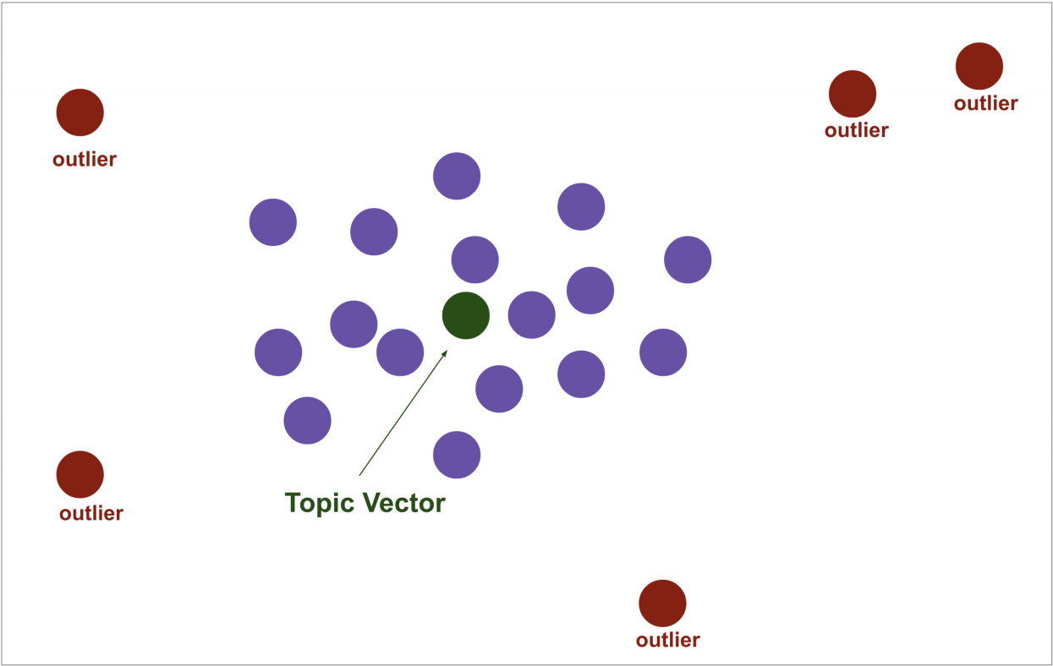
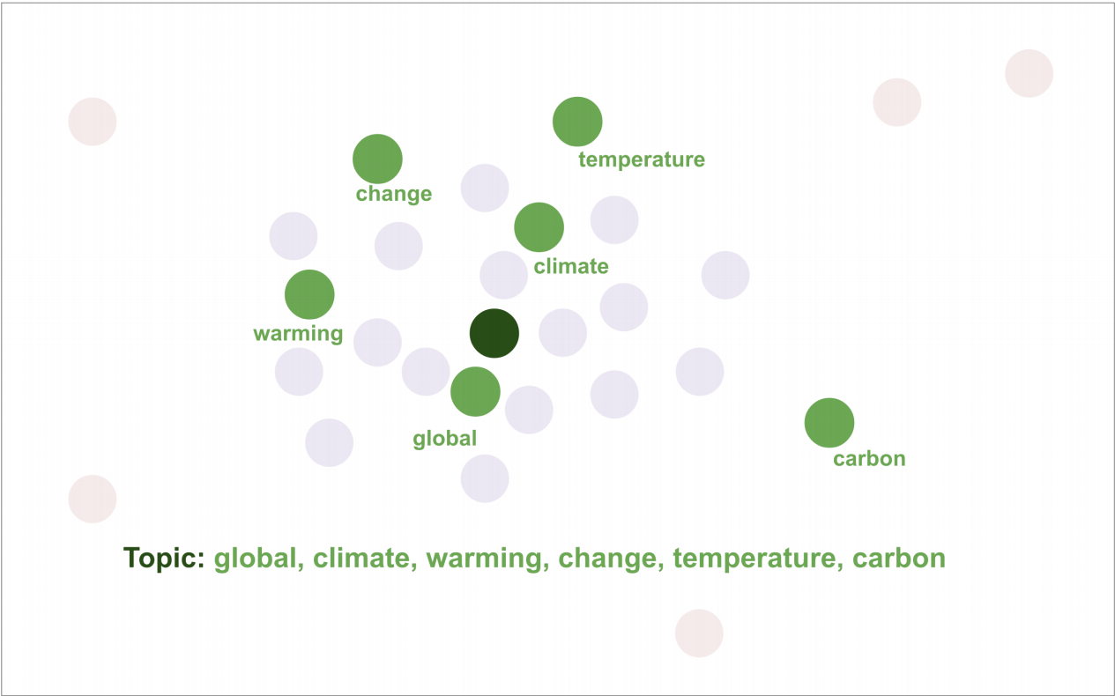
Topic Vectors
Topic vectors are now calculated. The centroid, i.e., the arithmetic mean of all the document vectors in the same dense cluster of those vectors is calculated. This centroid is the topic vector which is most representative of the the dense area of documents it was calculated from. The words that are closest to this topic vector are the words that best describe it semantically. The main assumption behind top2vec is that the number of dense areas of document vectors equals the number of prominent topics.

